Slide 1
BJD Company Profile
To lead the connector markets in China with worldwide coverage of products and high quality services
2023

Slide 2
1
About BJD
2
Product and Market
3
Production
4
Company Vision
CONTENTS

Slide 3
1
About BJD
※ Company Profile
※ Company Organization
PART
※ Company Development
※ Company Branch

Slide 4
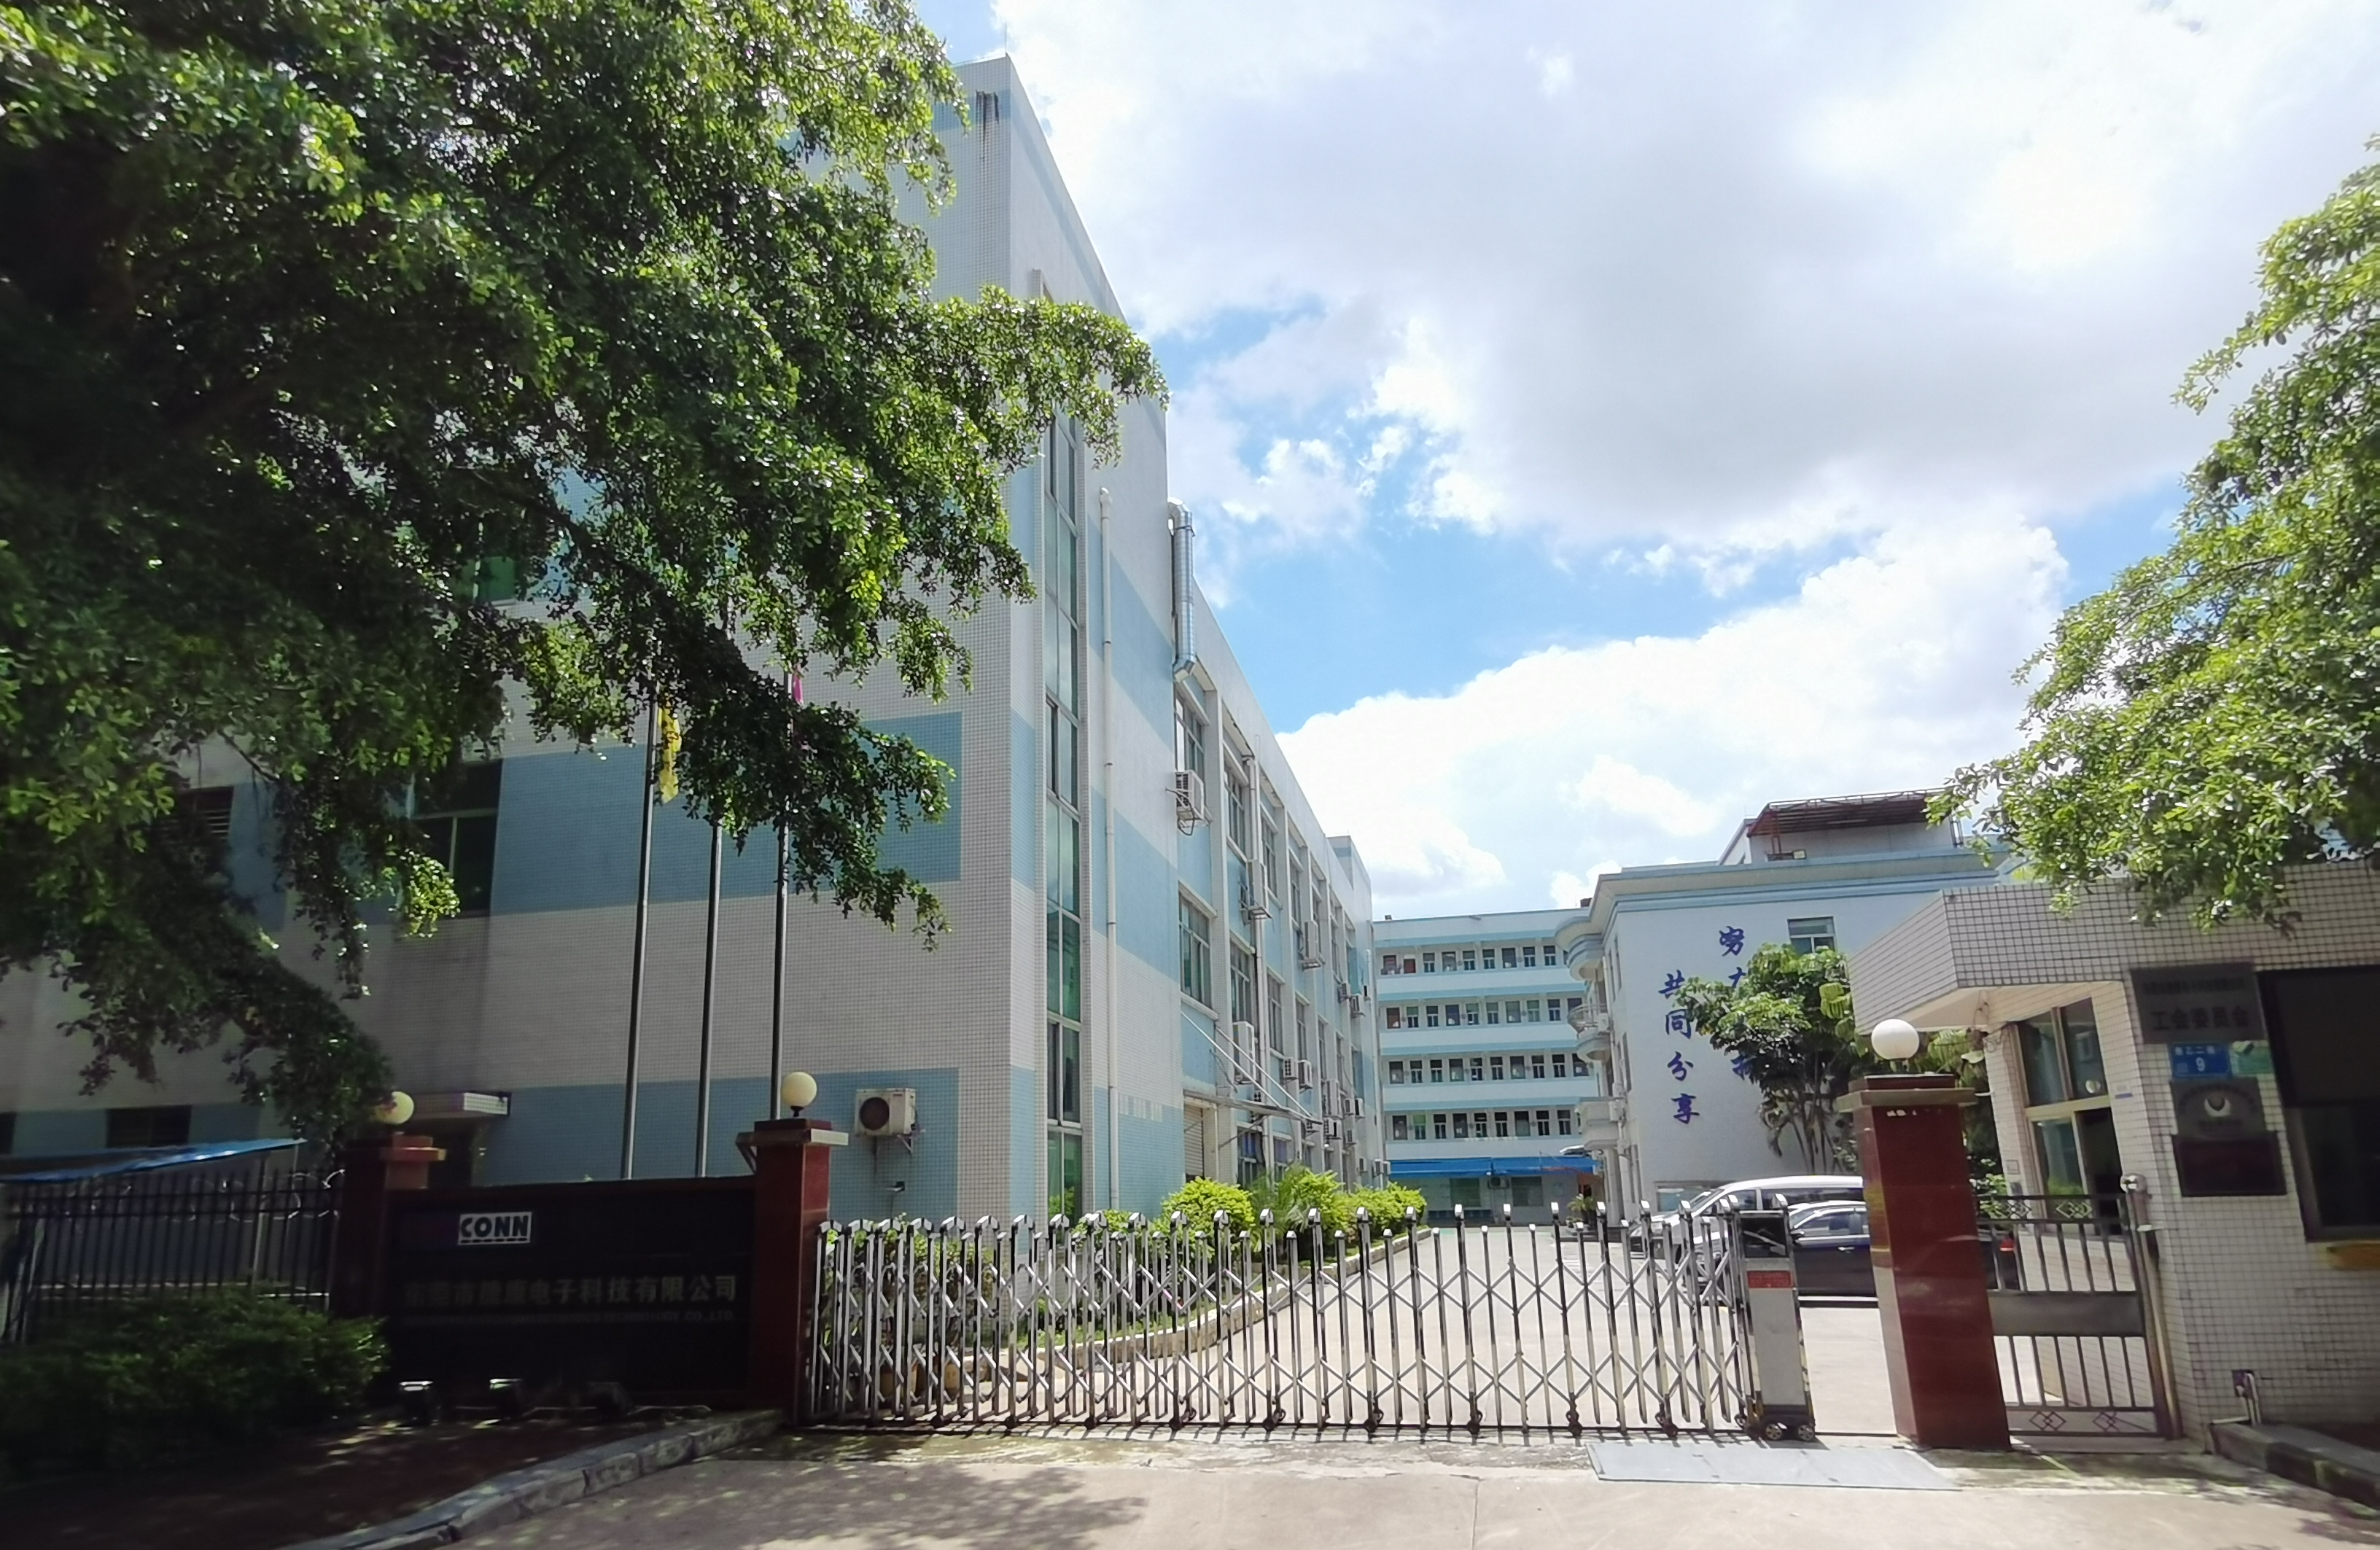
Company Profile
BJD&JUSTCONN
About Us
Established in 2004, BJD entered into the automotive electronics industry early and offers a wide range of connector solutions used in the automotive electronics, consumer and industry market.
Product Portfolio: FPC Connector, FFC, FAKRA&HSD, Floating B-to-B, Wire-to-Board Connector, SMB Connector,
I/O Connector and new energy Connector.
Capability
Injection Molding | Stamping | Assembly Automation
Product and Automated Production Line:
Independent Design and Development.
Team
500+ Employees
Notes:
人数少，产能高，自动化程度。日本有两名研发。汽车电子类连接器，日系品牌技术成熟，比如广濑，Kyocera京瓷，IRISO

Slide 5
Company Development
BJD&JUSTCONN
2004
2005-2010
2012-2016
2017-2023
2024
Vietnam factory
Company
was established
FPC Conn. and FFC
Certificated
TS16949&ISO9001
Automation team
I/O Connector
Floating B to B Connector
FAKRA&HSD Product launch
Updated IATF16949
VDA 6.3 audit certification
Europe&USA market
Notes:
04年成立，08年通过认证，10年组建自动化团队，甚至可以给客户提供技术支持。根据市场情况，做生产调整， BTB, IO。 16年组件生产共产，服务于日系，佳能，富士Fujifilm，OA类客户.目前计划在欧洲美洲日本设立办事处

Slide 6
Company Branch
BJD&JUSTCONN
JUSTCONN Electronic (Dongguan) Co., Ltd
Plant 1: No. 9 Luyi Second Road
Plant 2: No. 7 Luyi Second Road
JUSTCONN Electronic (Vietnam) Co., Ltd(Planning)
BEIJIDA Electronics (Shenzhen) Co., Ltd
BEIJIDA Electronics (Hong Kong) Co., Ltd
BEIJIDA offices in China: Shanghai, Nanjing,
Chongqing
Sales Office in Europe: Frankfurt, Germany
Office (Planning): Detroit, USA
Plant
Plant(Planning)
Office in Asia
Global Office
R&D Center Office: Japan
Notes:
2016年建立越南厂，目前主要做consumer products, 8月份会转移车载用品

Slide 7
2
Product and Market
※ Market Performance
※ Product & Market Cover
PART
※ Business Partner
※ Product Applications

Slide 8
Market Performance
BJD&JUSTCONN
Start to enter FPC
and FFC market
Focuse on Automotive
Electronics
R&D and produce
B TO B connector
Expand abroad marketing
R&D and produce
I/O Connector
(Target)
(Target)
Notes:
2021年，3个亿人民币，2022年目标3.5亿， 25年五亿。

Slide 9
Market Performance
BJD&JUSTCONN
2022Y Sales Distribution
2022Y Market Distribution
Notes:
global的客户出给国内工厂。今后的发展汽车电子为主导，维持到65到70

Slide 10
Business Partners
BJD&JUSTCONN
End customer
Notes:
visteon 10年开始合作， preh（15年均胜收购）， 18年开始。

Slide 11
Business Partner
Screen Market
LED Market
Consumer&Others
Notes:
visteon 10年开始合作， preh（15年均胜收购）， 18年开始。

Slide 12
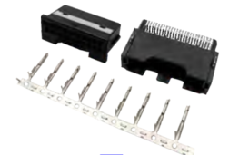
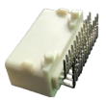
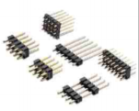
Main Business
BJD&JUSTCONN
FPC&FFC
I/O Conn. & FAKRA&HSD
Floating B to B
Automotive W T B
Customized Conn.
41%
14%
22%
15%
8%
Notes:
后期增长，定制件，banduiban，车灯连接器，

Slide 13
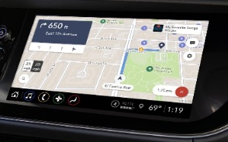
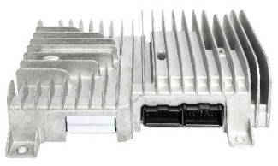
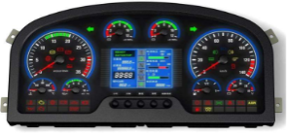
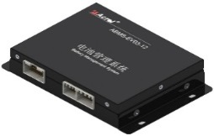
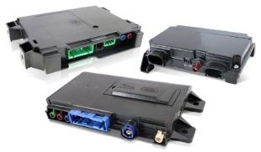
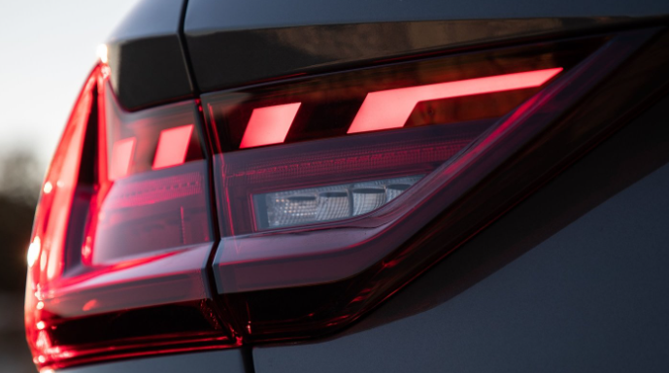
Product Applications
BJD&JUSTCONN
Navigation
Amplifier
Sunroof
Automotive
Air conditioner
Air Conditioner
AV system
Body control
Central control
Power system
Lighting
PTS
BMS
Meters
BCM
Engine ECU
BMS
EPS
PDU
Telematics
Lighting
Sensor
Notes:
导航空调主机，后期做优化，哪一类产品用在哪里，FPC对应。

Slide 14
Main Products
BJD&JUSTCONN
1/6 FFC/FPC Conn.
Stable design structure
Electrical properties
With lock position design
High reliability of FFC assembly (anti-loosening, anti-tilt, anti-unassembled).
Terminal double contact design
Good shock resistance
FFC ground structure, compatible with impedance control
Simplified FFC shielding process, higher quality and reliability
High-speed signal transmission
0.5-1.0 Pitch
FPC Conn.
Multiple choice
Easy to assemble
Compatible with common standard & convex lock position & concave lock position FFC assembly
Compatible with 5 different PCB LAYPUT requirements
Zero insert force
Notes:
常用的都有开发，优势，1 产品品类多，适配性强，匹配到市场上各个品牌的不同型号。高速传输，带屏蔽和接地的特殊要求的功能。同步生产与FPC匹配使用的FFC(柔性扁平线)

Slide 15
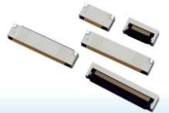
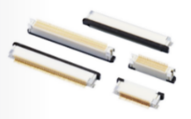
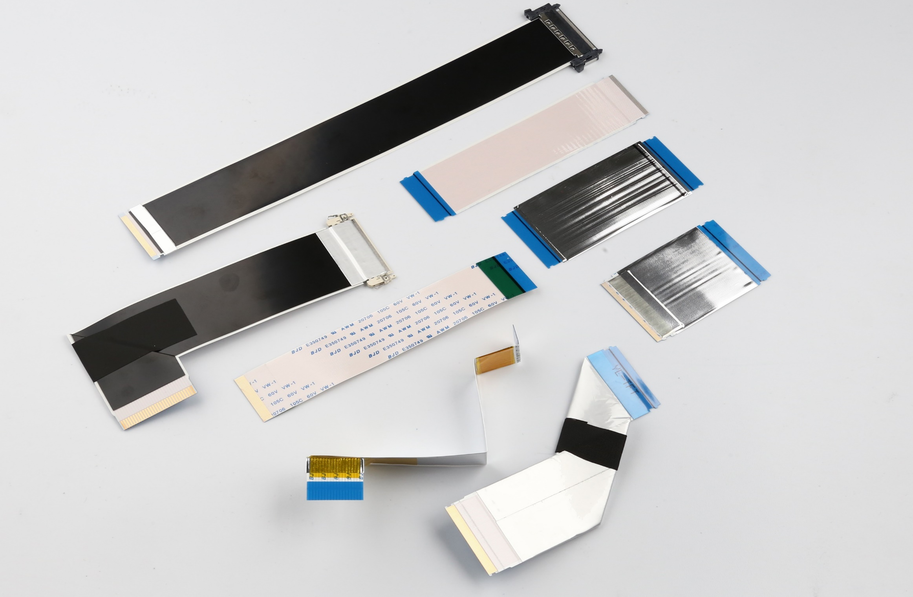
Main Products
BJD&JUSTCONN
1/5 FPC/ FFC Conn. Customer Cases
SVW CRS3.0
0.5-18-10PINS
0.5-18-50PINS
0.5-22-50PINS
0.5-22-68PINS
...
MTK plateform item
0.5-18-80PINS
0.5-18-10PINS
0.5-18-60PINS
J59 global item
0.5-18-10PINS
0.5-18-30PINS
0.5-18-40PINS
0.5-18-50PINS
0.5-18-60PINS
WEY P03/P05
0.5-18-60PINS
0.5-18-50PINS
0.5-18-30PINS
0.5-18-10PINS
0.5-21-30PINS
0.5-21-50PINS
0.5-21-70PINS
FPKM
0.5-25-10PINS
0.5-25-16PINS
0.5-22-60PINS
Automotive navigation
0.5-18 series FPC connector
0.5-23 series FPC connector
Notes:
常用的都有开发，优势，1 产品品类多，适配性强，匹配到市场上各个品牌的不同型号。高速传输，带屏蔽和接地的特殊要求的功能。同步生产与FPC匹配使用的FFC(柔性扁平线)

Slide 16
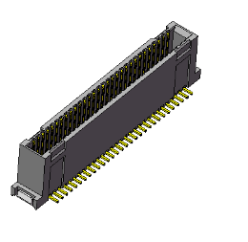
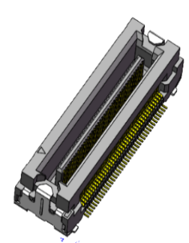
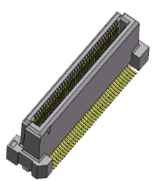
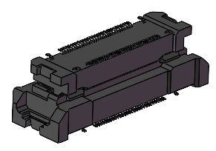
Main Products
BJD&JUSTCONN
2/6 Floating B to B
0.8 Series
0.635 Series
0.5-5 Series
0.8mm Pitch / XY±0.5mm floating,
30~80Pins / 6~24.7mm stacking height
0.63mm Pitch / XY±0.7mm floating,
60~80Pins / 6~15mm stacking height
0.5mm Pitch / XY±0.6mm floating,
20~120Pins / 8~30mm stacking height
High speed 8Gbps+ / High current 5A*4Pin
0.5-6 Series
0.4 Series
0.5-8 Series
0.5mm Pitch / XY±0.5mm floating,
30~120Pins / 5~20mm stacking height
High speed 6Gbps+
0.4mm Pitch / XY±0.4mm floating,
20~60Pins / 3~4mm stacking height
High speed 8Gbps+
0.5mm Pitch / XY±0.8mm floating,
20~160Pins / 10~30mm stacking height
High speed 16Gbps+ / High current 3A*4Pin
Notes:
在国内市场，北极大市场占有率很高。突破了很多连接器的技术壁垒，匹配性强，很多品牌做替换。 1 iriso 3 兼容HRS FX23系列。最大的优势 XYZ方向 0.5到0.7浮动量，避免路过坑洼路面 产生晃动，导致的损坏。Break through the technical barriers of many connectors, strong matching, replace many brands

Slide 17
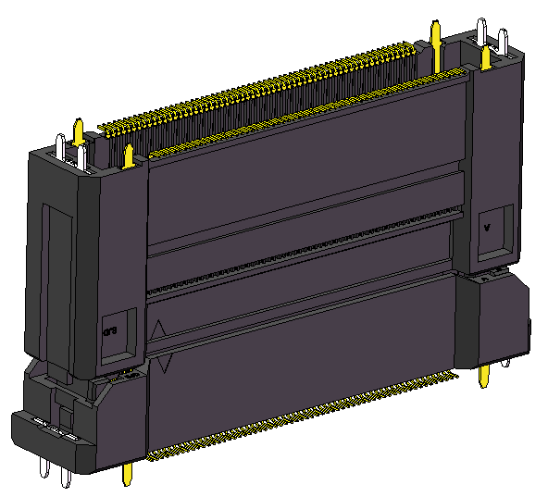
Main Products
BJD&JUSTCONN
2/6 Floating B to B Customer Cases
CRS3.0, MTK platform
BTB 0.8-5 60P
BTB0.8-5-80P
BTB 0.8-6 60P PLUG
BTB 0.8-6-80P REC
MTK Platform Geely HUD
BTB 0.5-5-120P H25mm
BTB 0.5-5-100P H25mm
BTB 0.5-5-60P H25mm
BTB 0.5-5-120P H20mm
IHU Platform Global (Central Control)
BTB 0.5-5-80P H30mm
BTB 0.5-5-80P H25mm
BTB0.8-5 90°PLUG/REC
A08, A09 Domain controller
BTB 0.5-5-60P H20MM
Notes:
在国内市场，北极大市场占有率很高。突破了很多连接器的技术壁垒，匹配性强，很多品牌做替换。 1 iriso 3 兼容HRS FX23系列。最大的优势 XYZ方向 0.5到0.7浮动量，避免路过坑洼路面 产生晃动，导致的损坏。

Slide 18
Main Products
BJD&JUSTCONN
3/6 Pin Header & I/O
Good vibration resistance performance
Stable performance and reliable quality
Customized per customer requirements
Compatible with the layout and wire harness side connector which commonly used in the market.
Multiple choices
Wave solder type
SMT-Reflow type
Pin in paste type
Easy to assemble, low insertion force
Notes:
在国内市场，北极大市场占有率很高。突破了很多连接器的技术壁垒，匹配性强，很多品牌做替换。 1 iriso 3 兼容HRS FX23系列。最大的优势 XYZ方向 0.5到0.7浮动量，避免路过坑洼路面 产生晃动，导致的损坏。Break through the technical barriers of many connectors, strong matching, replace many brands

Slide 19
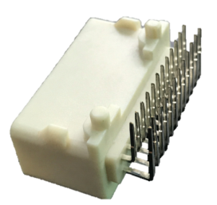
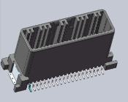
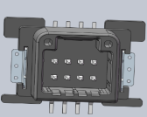
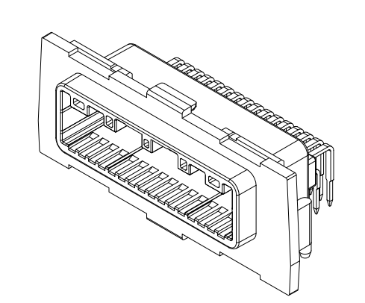
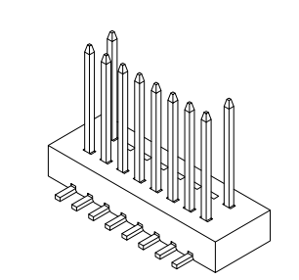
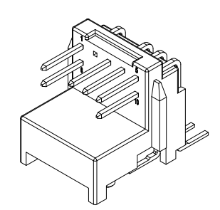
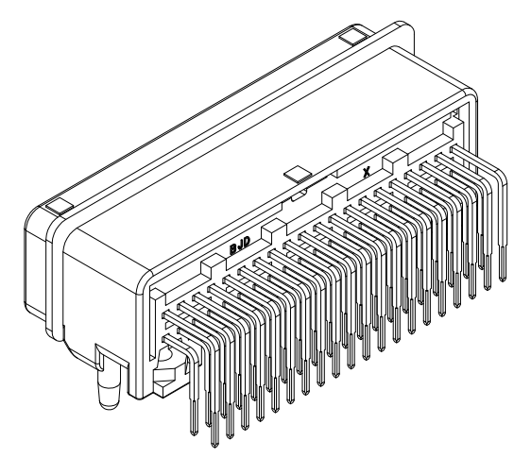
Main Products
BJD&JUSTCONN
3/6 Pin Header & I/O Customer Cases
T-BOX、360
025 Series 40pins、025 Series 8pin SMT
Air conditioning
14PIN-SMT
-180 connector
Car networking-RADAR
P2.2-8-32PINS
Car air conditioning(H6+VV5)
P2.2-1-10PINS
P2.5-1-6PINS
Meters items for platform
Notes:
定制为主，优势是强大的研发团队做技术支持。使用进口材料， 推出PIP SMT贴装工艺为主，有效为客户节省生产和组装成本

Slide 20
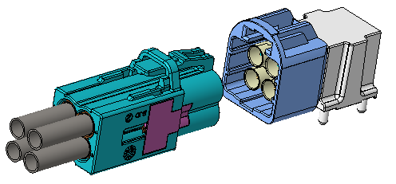
Main Products
BJD&JUSTCONN
4/6 FAKRA&HSD
■ Multiple codes
■ Could be compatible with the layout and wire harness side connector which commonly used in the market
■ Stable performance and reliable quality
■ Provide customers with a variety of solutions
Application
High Speed Cable Networking
Sensor Device Connectivity
Gateway / Switch Module
ADAS
GPS / Infotainment
Camera / Surround View
High Resolution Displays 4K
Taxi/Shared Ride fleets
Self Driving tractors for farming
Self Driving Construction/mining
Notes:
兼容TE 和 Rosenberger， mini 4 in 1 SMB产品 以太网 在研发中

Slide 21
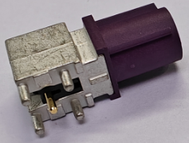
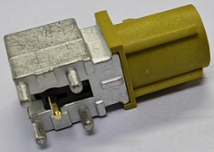
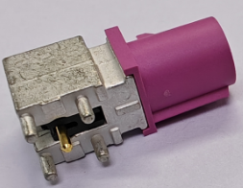
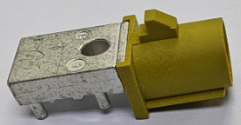
Main Products
BJD&JUSTCONN
4/6 FAKRA&HSD Customer Cases
Infotainment
140022-400450
ADAS
140022-401050
140022-400850
ADAS
140019-210150
140022-400450
Notes:
定制为主，优势是强大的研发团队做技术支持。使用进口材料， 推出PIP SMT贴装工艺为主，有效为客户节省生产和组装成本

Slide 22
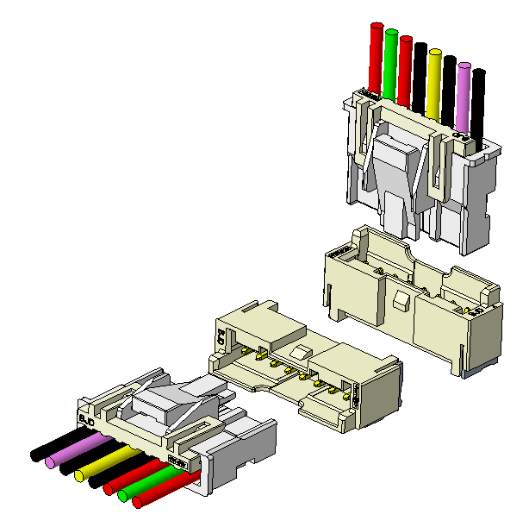
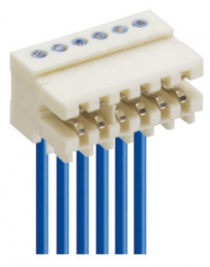
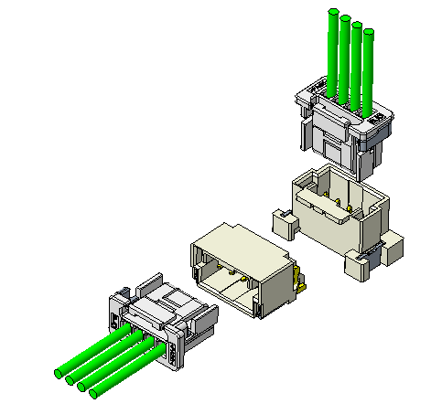
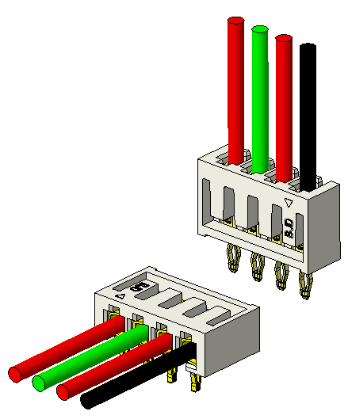
Main Product
BJD&JUSTCONN
5/6 Automotive W to B connector(1)
■ Offers a variety of pitch options
■ With secondary locking structure (TPA)
■ With anti-slant insertion/blind insertion function
■ Closed terminal construction
■ The operating temperature of the product: -40℃~+125℃
■ End Customers: BYD, GAC, NISSAN, Geely, Changan, SAIC Volkswagen,
Toyota, SAIC-GM, NIO, Huawei, BAIC, Yutong, Chery, JAC, etc.
Automative Applications
■ BMS
■ Lighting
■ Fan
■ HUD
Notes:
线对板连接 兼容JST 和Molex 的部分型号Compatible with some models of JST and Molex

Slide 23
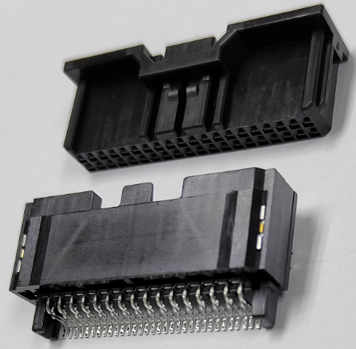
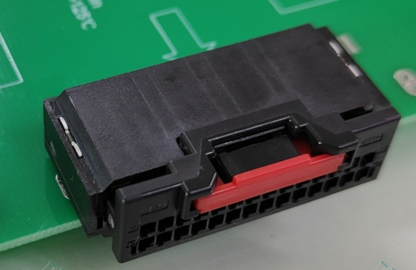
Main Products
BJD&JUSTCONN
5/6 Automotive W to B connector(2)
With CPA option
■ 2.0mm Pitch, 8-40PIN
■ Double row low height: total height after pairing: 9.35-11.05
■ With secondary lock structure: TPA&CPA
■ Strong vibration resistance: Closed terminal shape, 3 contact points
■ Product applicable temperature (long-term): -40℃ - +125℃
< Automative Applications >
■ BMS
■ lighting
■ Fan
■ ...
Notes:
兼容TE 和 Rosenberger， mini 4 in 1 SMB产品 以太网 在研发中

Slide 24
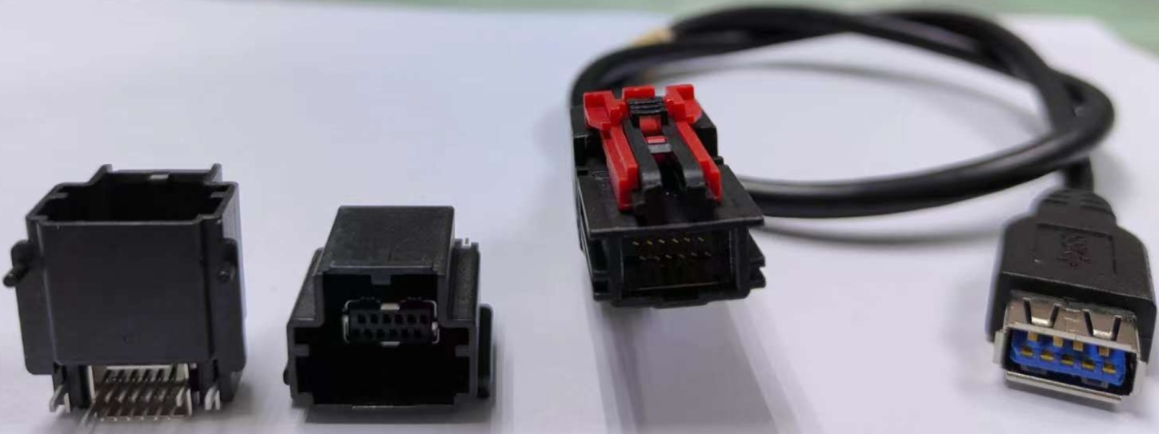
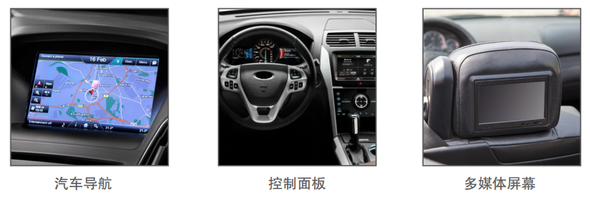
Main Products
BJD&JUSTCONN
6/6 USB Connector(HSAL II)
Transfer Protocol
Multiple high-speed transport protocols can be supported, such as:
FPD-Link4(13.5Gbps)
USB3.1(5Gbps)
LVDS (8Gbps-4Gbps per channel)
DisplayPort
Complete development, production, and sales of
wire harnesses and board-end assemblies.
Application
Infotainment system
Telematics
Security and Collision Avoidance Cameras
Navigation System
Connected Vehicle Services
ADAS
GPS
Control Panel
Multimedia Screen
Notes:
兼容TE 和 Rosenberger， mini 4 in 1 SMB产品 以太网 在研发中

Slide 25
3
Production Capacity
※ Manufacturing Capability
※ Quality system
PART
※ Internal Lab.

Slide 26
Manufacturing Capability
BJD&JUSTCONN
Stamping
Fully automated production level reaches over 90%
Mold
manufacture
Have advanced fully automated production line in China
Automation
Injection
Japanese personnel manage production
and technology
Notes:
原材料到出货都是在厂内完成，有效的控制了质量 成本 日本人做管控，自动化程度高From raw materials to shipments are completed in the factory, effectively controlling the quality and cost 。
From raw materials to shipments are completed in the factory, effectively controlling the quality and cost

Slide 27
Manufacturing Capability
BJD&JUSTCONN
Customization
Precision
Stable quality
Advanced injection
machine FANUC
Advanced stamping
machine YAMADA
Strong R&D team
Independent design of Automation line
Notes:
1. 工厂内部的 注塑和冲压模具，生产精密零部件，2，注塑车间用的FANUC 3yamada 品牌 组装 内部的研发团队。

Slide 28
Equipment status
BJD&JUSTCONN
Equipment | Model | Process | QTY | Equipment | Model | Process | QTY
Conn. Injection machine | Japan FANUC 50T/Taichung Seiki | Injection | 25 | Automatic inspection machine自动检查机 | Independent design | FFC size inspection | 11
Conn. Stamping machine | YAMADA | Stamping | 14 | Edge punching machine冲边机 | Independent design | FFC punching | 7
Conn. automatic assembly machine | Independent design | Assembly | 50 | Automatic punching machine冲卡扣机 | China | FFC punching | 3
Conn. Semi-automatic assembly machine | Independent design | Assembly | 10 | Automatic line drawing machine 自动画线机 | China/CTY | FFC line drawing | 3
Conn. Winding machine卷装机 | Independent design | Assembly | 6 | Cutting machine 切断机 | China/CTY | FFC cutting | 9
Wire drawing machine伸线机 | China/CTY | Conductor stretch拉伸 | 2 | Automatic folding machine折线机 | Independent design | FFC broken line processing | 2
Calender 压延机 | China/CTY | Conductor rolling 压延 | 5 | Automatic sticking machine贴麦拉机 | China | FFC paste wheat processing贴麦拉加工 | 2
Pressing machine 压合机 | China/CTY | FFC pressing压合 | 8 | Automatic laser machine镭射机 | Taiwan/mileage Technology | FFC shield processing | 1

Slide 29
Quality system
BJD&JUSTCONN
两化融合
IATF16949
ISO9001
ISO14001
UL Qualification
INTERTEK Certifiction
WIT Certification
WIT Certification
UL Certification
BJD has more than 40 product technology patents. In 2022, BJD won the titles of ‘Provincial Specialized and Special New Enterprise’ and ‘Dongguan New Automotive Electronic Connector Engineering Technology Research Center’.

Slide 30
Testing capability
BJD&JUSTCONN
Dimension
Secondary
Projection instrument Micrometer
Mechanical
Terminal bend-resistant test Terminals and connectors insert and Pull out connection forces Drop test
Mechanical strength test
Mechanical pull and lateral force load tester
Mechanical vibration and shock
D
E
E
M
Environmental
Temperature and humidity cycle test
Hot and cold shock
High temperature test
Salt spray test
Corrosion-resistant testing
Mixed flow gas test
Product Specification
In addition to IATF16949, ISO9001, ISO14001 certified, BJD's in-house laboratory serves as an umbrella to protect all products to meet customer and design engineering requirements.The CNAS certification laboratory is under construction, and the certification will be completed by the end of 2023
Electrical Pressure-resistant tester
Contact resistance
Insulation resistance
Insert loss
Electrical continuity testing
Notes:
2025年 成立

Slide 31
Testing capability- BJD Laboratory
BJD&JUSTCONN
Testing Room 1
Testing Room 2
Testing Room 3
Testing Room 3
Testing Room 4
Testing Room 5

Slide 32
Testing capability- BJD Laboratory
BJD&JUSTCONN
Mechanical performance test
Dimension measurement
Insertion/withdrawal force test
Contact Retention test保持力测试
Normal force test正向力测试
Shock Test机械冲击测试
Vibration test with temperature and humidity带温度湿度振动测试
Tumbling test滚筒跌落测试
Electrical performance test
Electric Strength test耐压测试
Continuity test导通测试
Insulation resistance test绝缘电阻测试
Contact resistance test接触电阻测试
Temperature rise test温升测试
Instant break test 瞬断测试
SI signal (IL, SWR, RL, Impedance, Eye Diagram) test
Environmental Experiment Test
Thermal shock test 冷热冲击
Humidity resistance test温湿度循环试验
Salt spray test盐雾试验
High temperature test高温试验
High and low temperature experiment高低温实验
Reflow experiment 回流焊实验
Others
Environmental testing环保测试
Film thickness test膜厚测试
Moisture test水分测试
Solderability Test可焊性测试
X-ray perspective detection

Slide 33
4
Company Vision
※ Product Roadmap
※ Vietnam Plant Plan
PART
※ R&D Capability&

Slide 34
Product Roadmap
Design Begin date
SOP date
No. | Product | Picture | 2022 Y Q4 | 2023 Y Q1 | 2023 Y Q2 | 2023 Y Q3 | 2023 Y Q4 | 2024 Y Q1 | 2024 Y Q2
1 | H-MTD Ethernet
2 | Mini FAKRA(Four in one)
3 | 0.4 PITCH FPC Conn 80-120P
排针排母
牛角
USB
INTERTEK Certifiction
WIT Certification
WIT Certification
UL Certification

Slide 35
Product Roadmap
Design Begin date
SOP date
No. | Product | Picture | 2022 Y Q4 | 2023 Y Q1 | 2023 Y Q2 | 2023 Y Q3 | 2023 Y Q4 | 2024 Y Q1
4 | Auto-Lock FPC/FFC Connector
5 | 16Gb 240 Floating BTB (smart cockpit)
6 | 0.4 Pitch Floating BTB Connector
RA type
ST type

Slide 36
Product Roadmap
Design Begin date
SOP date
No. | Product | Picture | 2022 Y Q4 | 2023 Y Q1 | 2023 Y Q2 | 2023 Y Q3 | 2023 Y Q4 | 2024 Y Q1
7 | Nanomqs type (Automotive lighting, new energy)
8 | FFC&FPC Board Conn (FPC&FFC directly Conn the Board PIN)
排针排母
牛角
USB
INTERTEK Certifiction
WIT Certification
WIT Certification
UL Certification

Slide 37
Product Roadmap
Design Begin date
SOP date
No. | Product | Picture | 2022 Y Q4 | 2023 Y Q1 | 2023 Y Q2 | 2023 Y Q3 | 2023 Y Q4 | 2024 Y Q1
9 | NANO MQS Series (40PIN, 48PIN)
排针排母
牛角
USB
INTERTEK Certifiction
WIT Certification
WIT Certification
UL Certification

Slide 38
Vietnam Plant Roadmap
BJD&JUSTCONN

Slide 39
Customization Cases
BJD&JUSTCONN
NO. | Product Name | Product Picture | Product Application | End Customer | SOP Date
1 | 36POL I/O connector |  | VW ConMod | AUDI VW | 2023
2 | P2.54-6P Pin header*2 P2.54-4P Pin header |  | MODEL 3 Platform | TESLA | 2019
3 | P2.54-3P Pin header P2.0-3P Pin header P1.8pitch-4P Pin header |  | MODEL Y Control Switch | TESLA | 2020
4 | 48PINS IO connector |  | Seat Control Switch (Platform) | Ford | 2020
5 | P3.5-24P pin header conn. |  | Amplifier | Daimler | 2024

Slide 40
Customization Cases
BJD&JUSTCONN
NO. | Product Name | Product Picture | Product Application | End Customer | SOP Date
6 | 14PINS-SMT-180 pin header |  | Air Conditioning Control | TOYOTA | 2021
7 | 025 series 40P pin header |  | Seat | GAC | 2020
8 | 9491 series 40P pin header |  | T-BOX | NISSAN/Chery/Wuling | 2019
9 | P2.2-8-32P pin header |  | Huawei Internet of Vehicles System | HUAWEI | 2020
10 | 0.5pitch-80P floating B to B |  | LED Display | Hikvision | 2020
11 | 0.5-18-60P FPC connector |  | VS30 Platform | Mercedes-Benz | 2019

Slide 41
Customization Cases
BJD&JUSTCONN
NO. | Product Name | Product Picture | Product Application | End Customer | SOP Date
12 | 0.5-22-50P FPC connector |  | MEB Platform | VW | 2018
13 | FAKRA-A Code |  | Navigation | FIAT/SAIC | 2019
14 | BTB 0.8-5-80P |  | MTK Platform | Geely | 2019
15 | BTB0.5-5 H25/120P |  | Domain Controller | SAIC | 2021
16 | BTB0.5-5 H25/60P BTB0.5-5 H25/100P |  | Domain Controller | Geely/Volvo | 2022
17 | BTB0.5-5 H20/60P |  | Smart Cockpit | GAC | 2023

Slide 42
Thank You for Watching！
To be the best connector supplier in China!

